Slide 1


Library Cleanup, loading and MinKNOW
ARTIC Network Train the Trainer - August 2022
ARTIC TRAIN 04AUG22 Rhys Izuagbe

Slide 2

Objectives
Define and detail the purpose and process of Library Cleanups
Outline the MinION Flowcell loading and priming procedures
Outline how to use the MinKNOW software and run a library

Slide 3
Library Cleanup
Principles of SPRI remain the same
Previously barcoded samples are pooled into a single volume
(Determined by the total number of samples)
Two SPRIs are conducted with adapter ligation occurring between
Notes:
Format and procedure change slightly

Slide 4

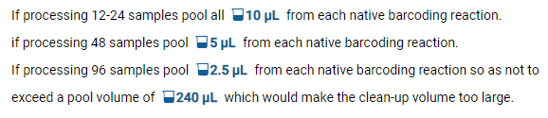

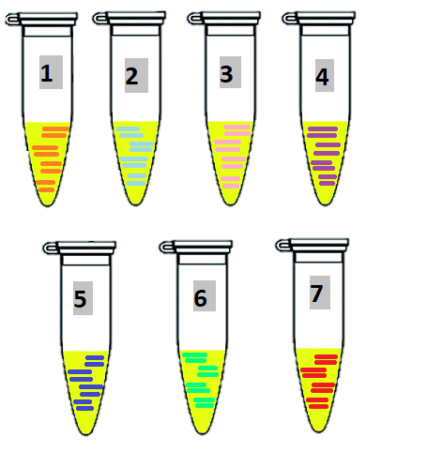
Pooling of barcoded samples
≥30 ng total concentration is needed to achieve max yield!
Volume of each sample is determined by the total number of samples
Pool barcoded amplicons of all samples into one tube
Library progressed to Cleanups

Slide 5



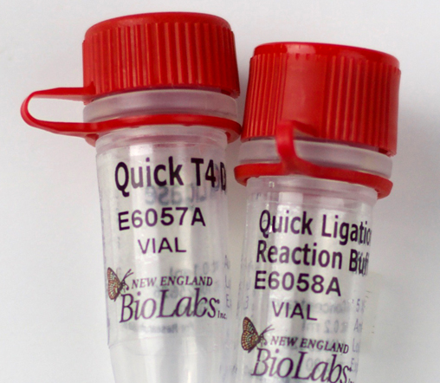

Library Cleanup
You will need:
NEBNext Quick Ligation Reaction Buffer (NEB)
Quick T4 DNA Ligase (NEB)
Adapter Mix AMII (Part of the Native Barcoding kit, ONT)
S Fragment Buffer SFB (ONT)
Elution buffer (EB, ONT)
Pooled barcoded samples
NOTE: The final library clean-up DOES NOT use ethanol.
Ethanol will destroy the Flow cell Motor Proteins.

Slide 6
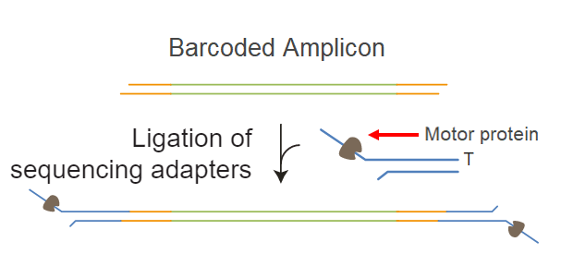
Library Cleanup
The first SPRI removes residual enzymes and un-ligated barcodes
Sequencing adapter are then attached to each end of the barcoded amplicons
The second SPRI then removes residual enzymes and un-ligated adapters

Slide 7

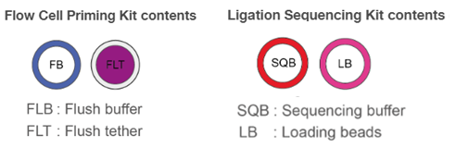
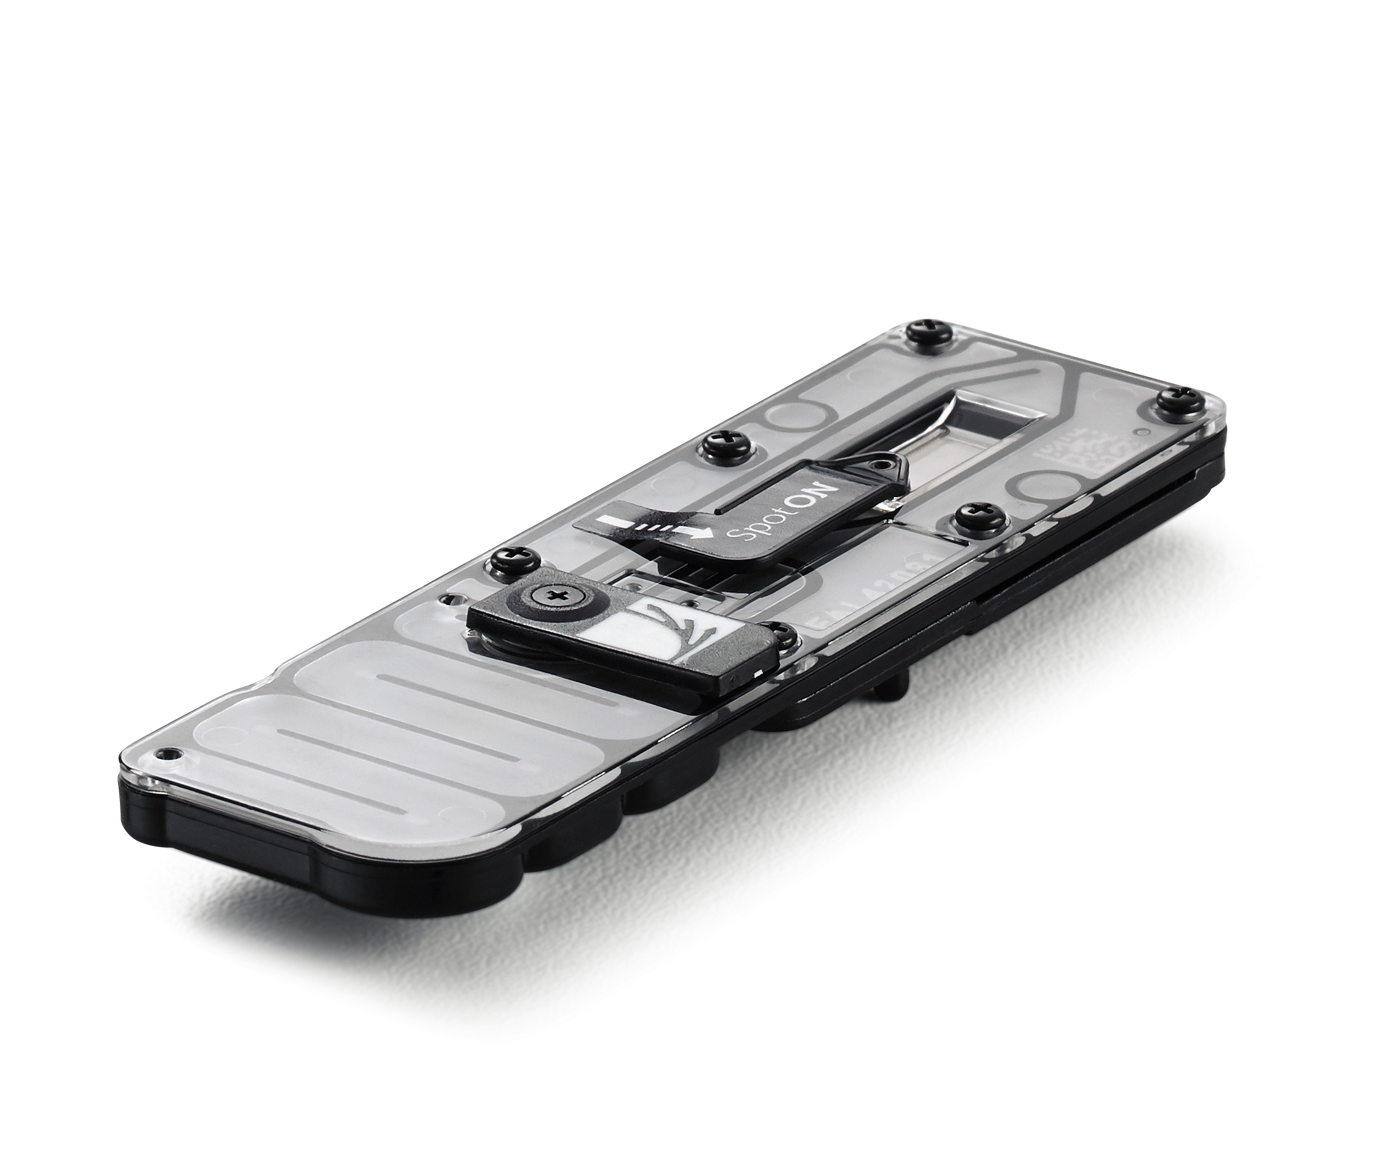
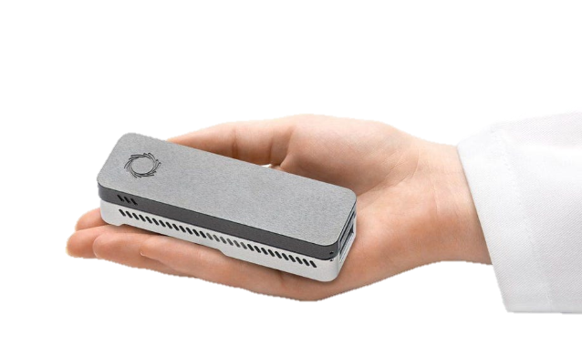
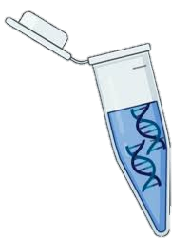
Loading a library
You will need:
Laptop running MiKNOW software
Flow cell Priming reagents FB and FLT (ONT)
Ligation sequencing reagents SQB and LB (ONT)
Flow cell
MinION
Your final library

Slide 8
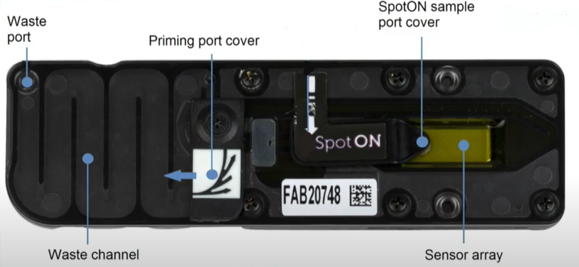
Flow cell priming
Anatomy of a Flow cell

Slide 9
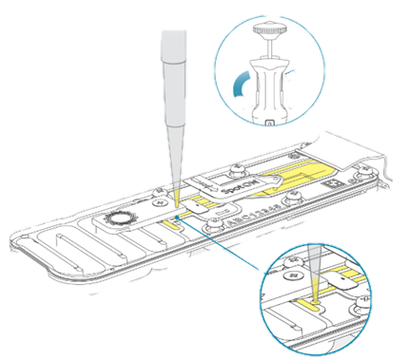
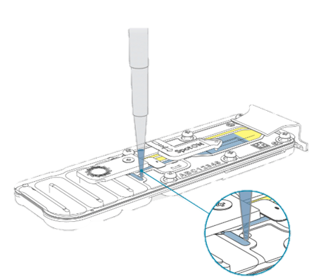
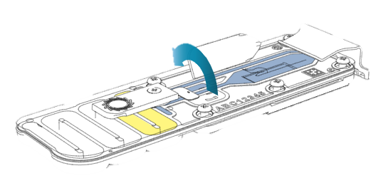
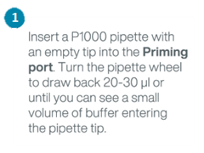
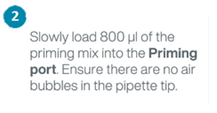
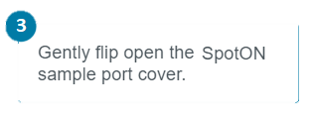
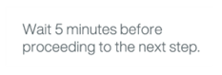
Flow cell priming

Slide 10
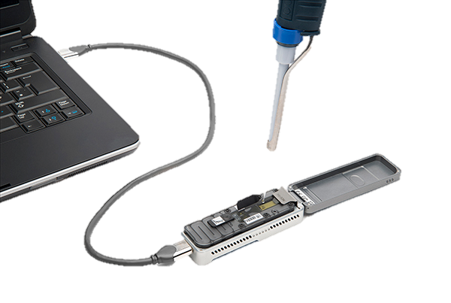
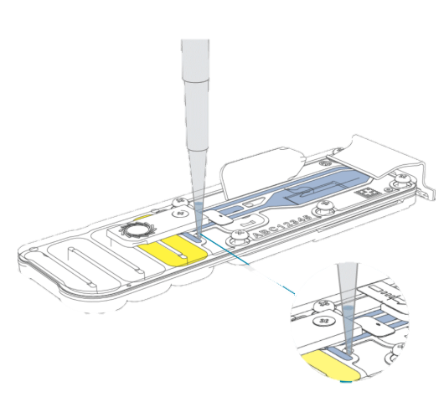
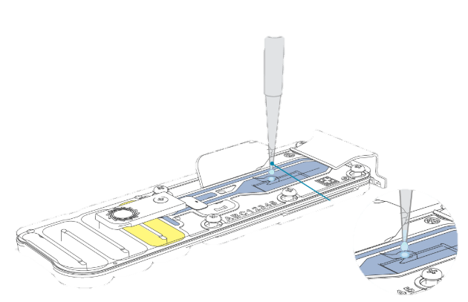
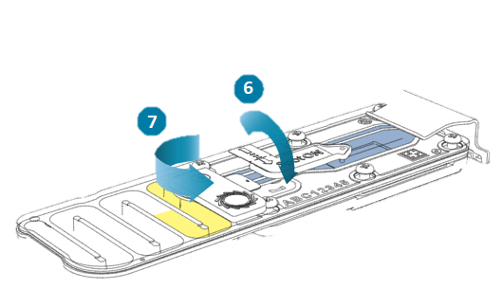
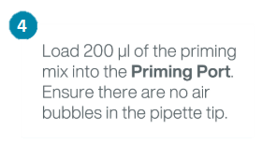
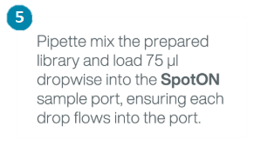
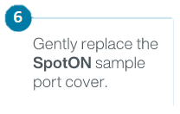
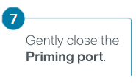
Flow cell priming

Slide 11

Priming & Loading Flow cell demo

Slide 12
MinKNOW
Propriety software used to operate ONT sequencing devices
Enables real-time data acquisition and monitoring of runs
Input run parameters and sample IDs
Capable of live base-calling dependent on local hardware
Prepare initial data for further analysis
Single program for all devices, can be streamed and controlled by app

Slide 13
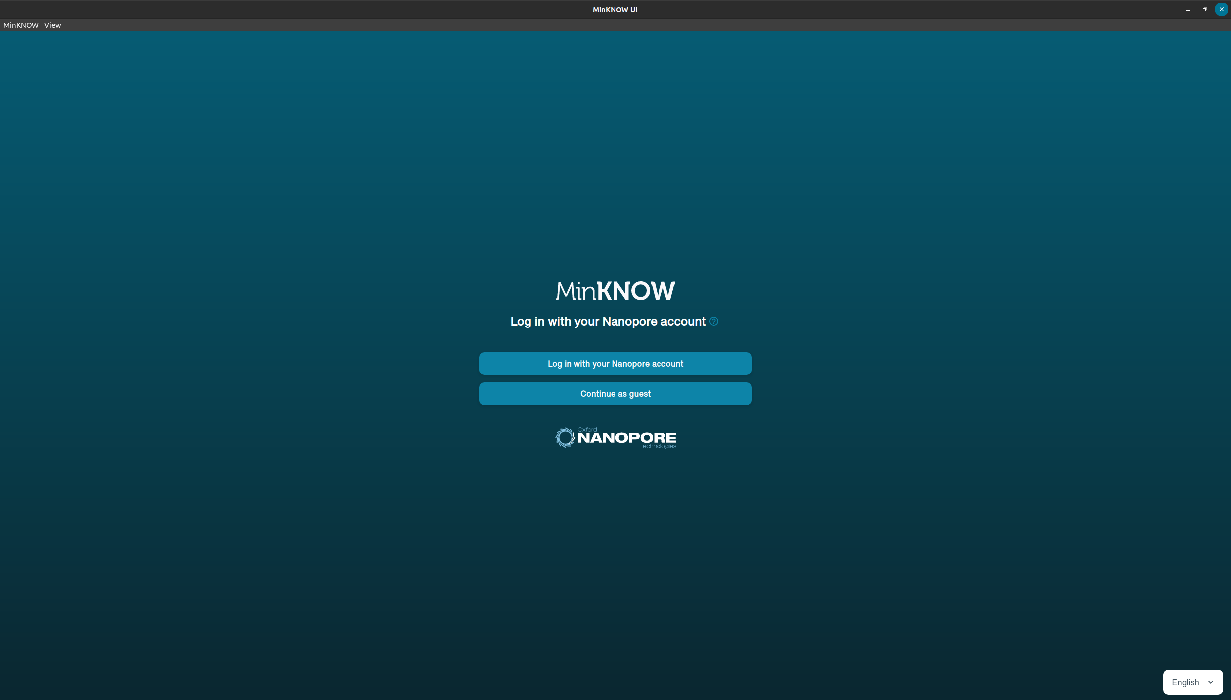
MinKNOW
Login

Slide 14
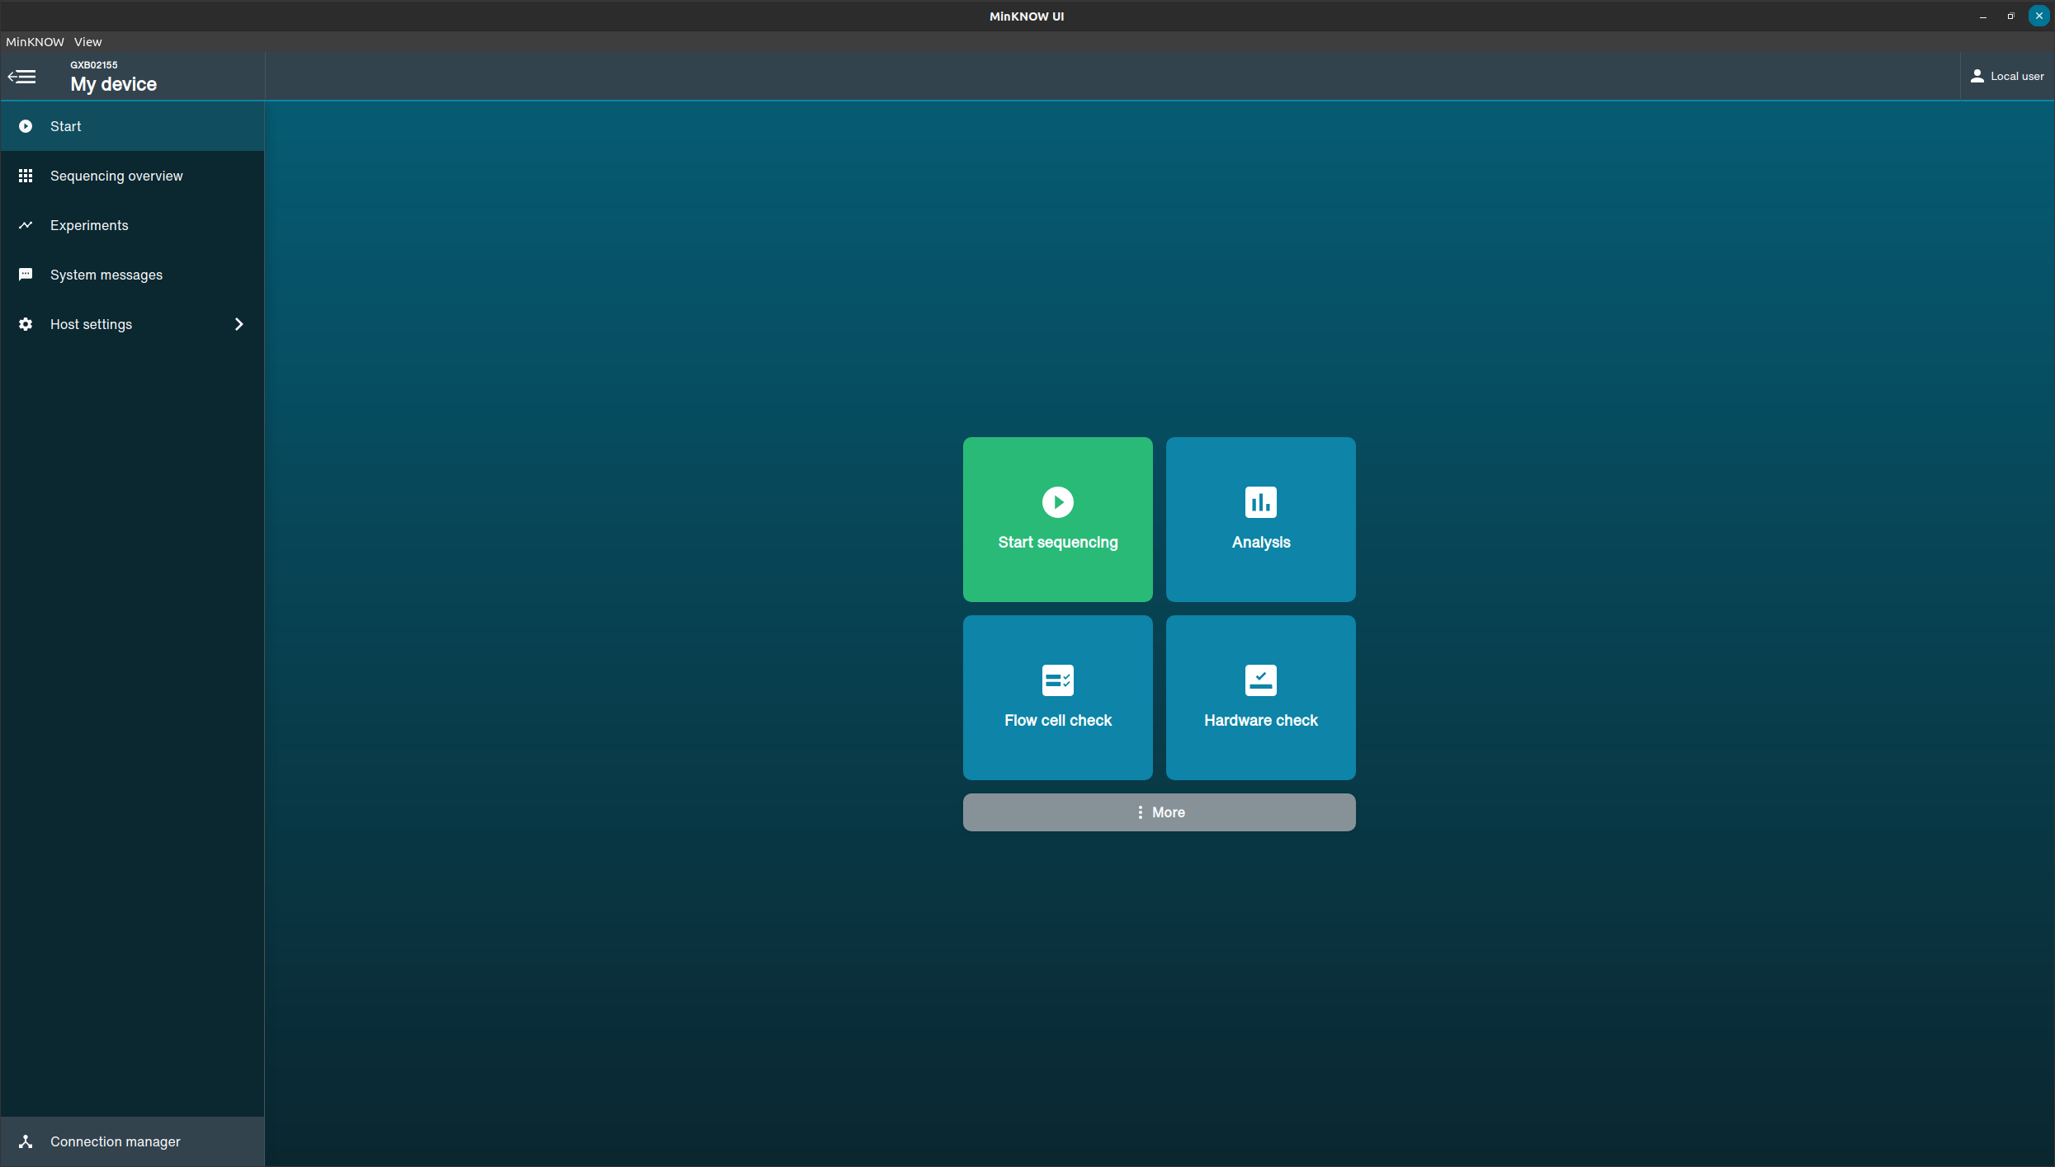
Heading
General functions

Slide 15
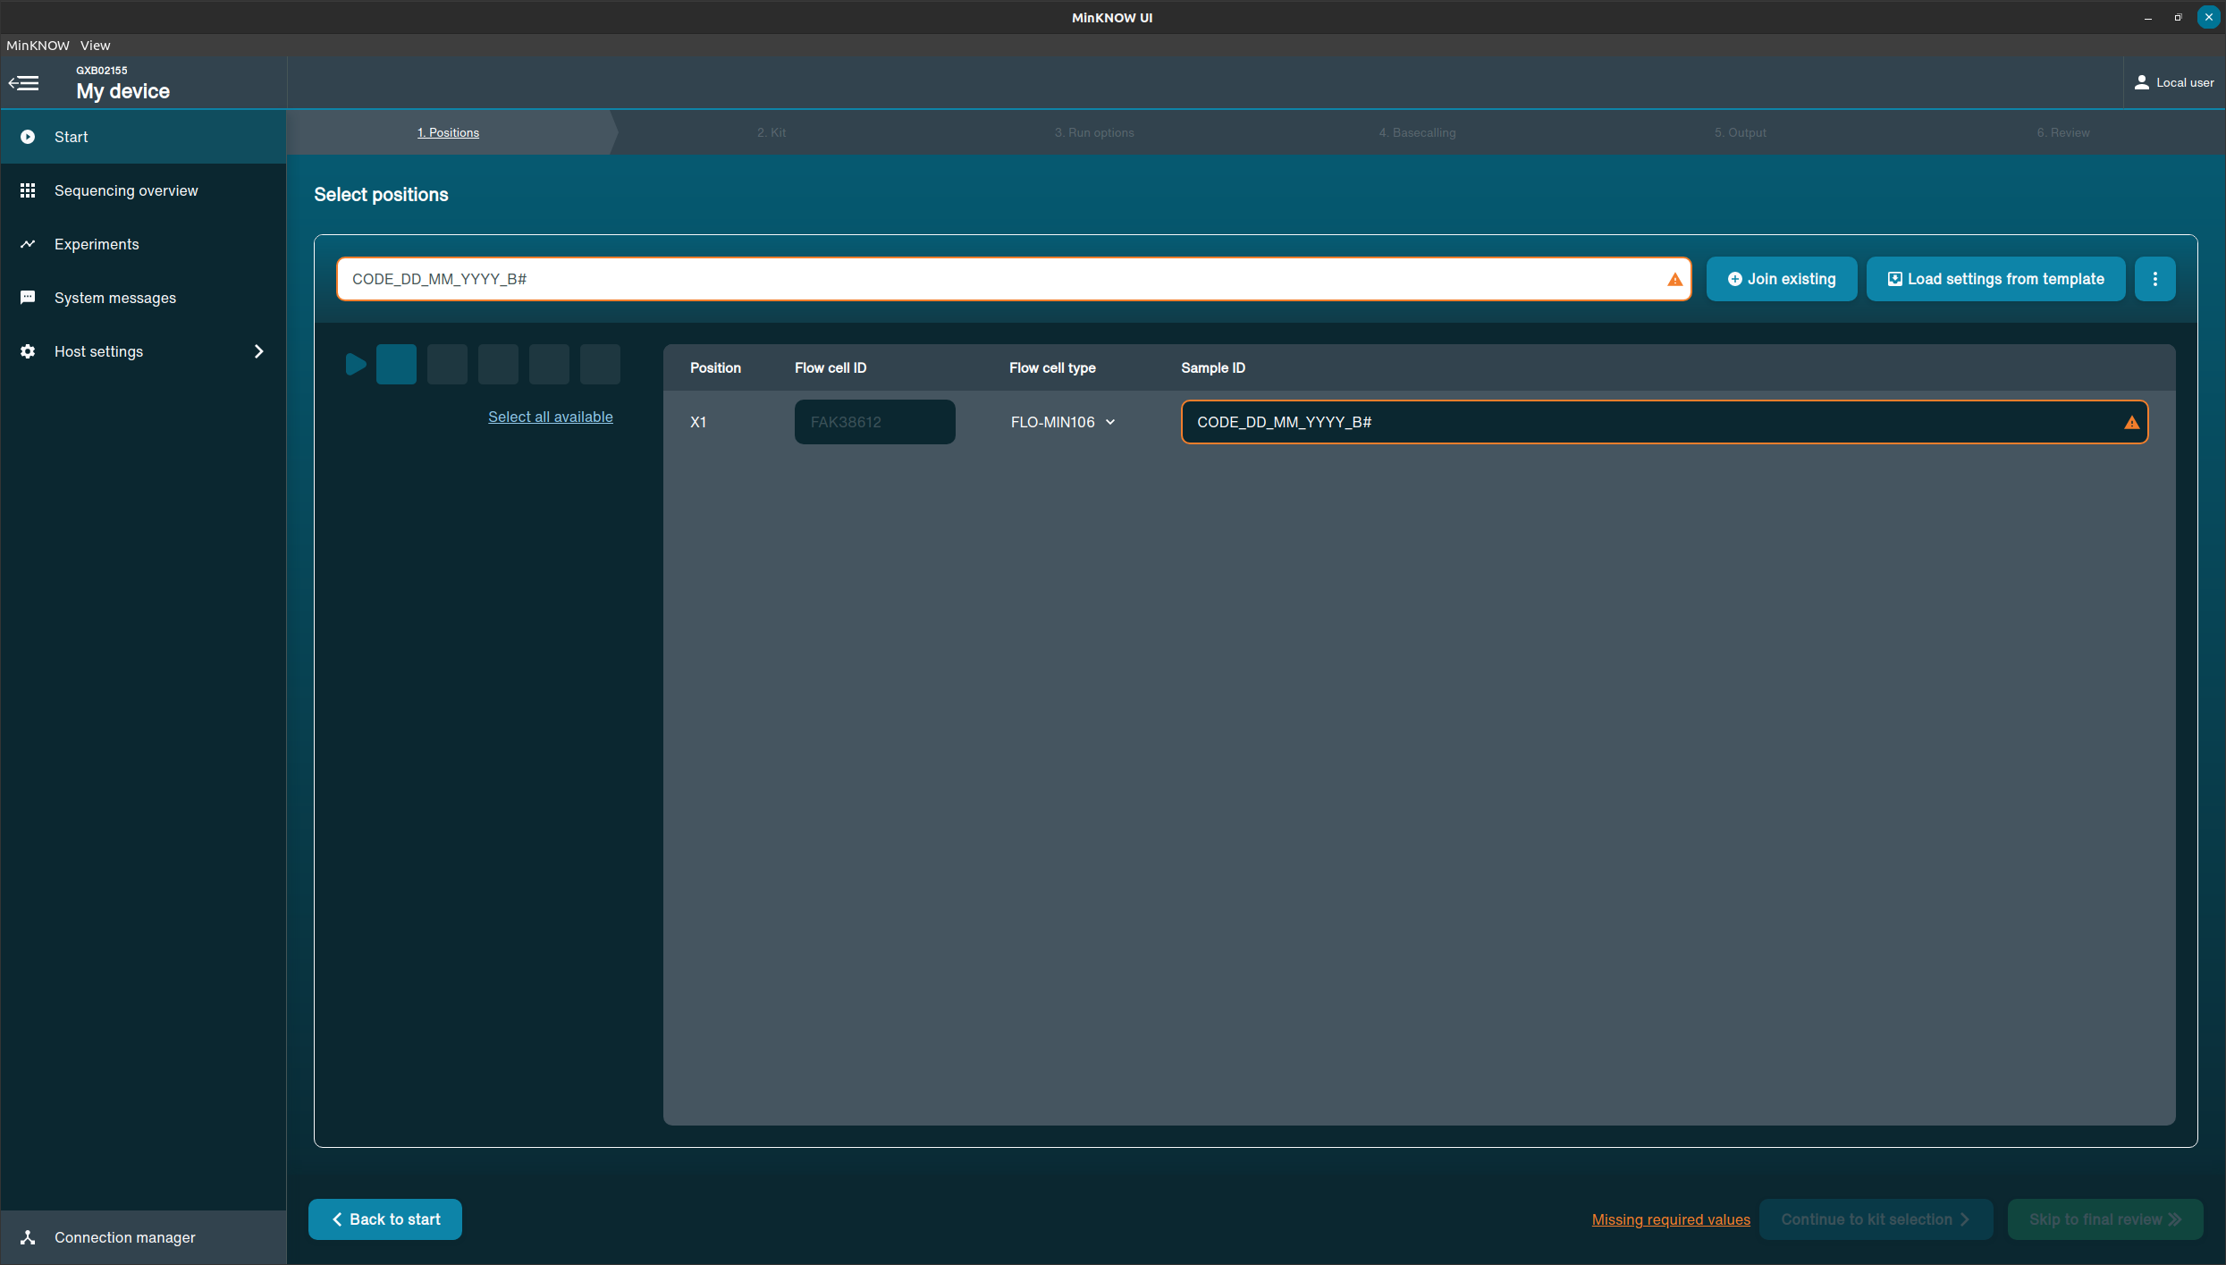
Starting a run

Slide 16
Naming Conventions
CODE_DD_MM_YYYY_B#
Current Date
E.g. 04_08_2022
Daily Batch number
E.g. B1, B2
Code: Laboratory specific
CSRS- Centre Suisse de Recherches Scientifiques
FAMT- Centre de Recherche sur les Filarioses & Autres Maladies Tropicales
GRAS- Groupe de Recherche Action Santé
ITEC- Centre d’Excellence Africain en Innovations BioTechnologiques pour l’Élimination des Maladies à Transmission Vectorielle
PCMT- Centre d’Excellence Africain pour la Prévention et le Contrôle des Maladies Transmissibles
PHAP- African Centre for Population Health and Policy
MRTC- Malaria Research and Training Centre
Example: GRAS_04_08_2022_B1

Slide 17
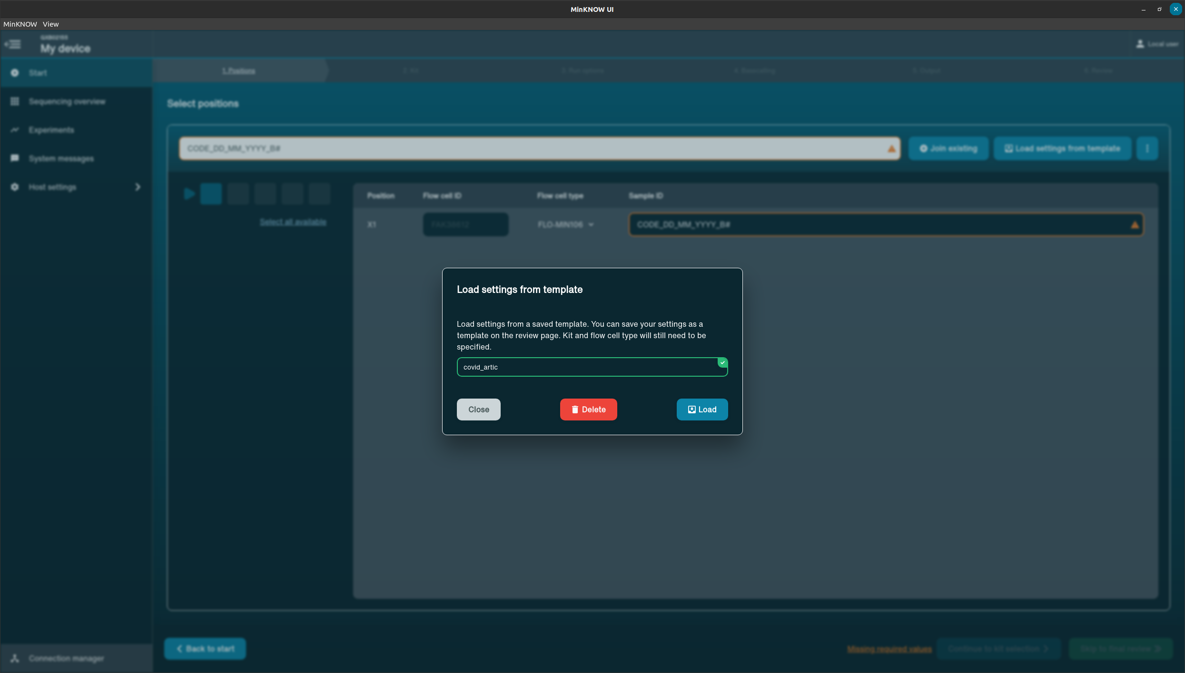
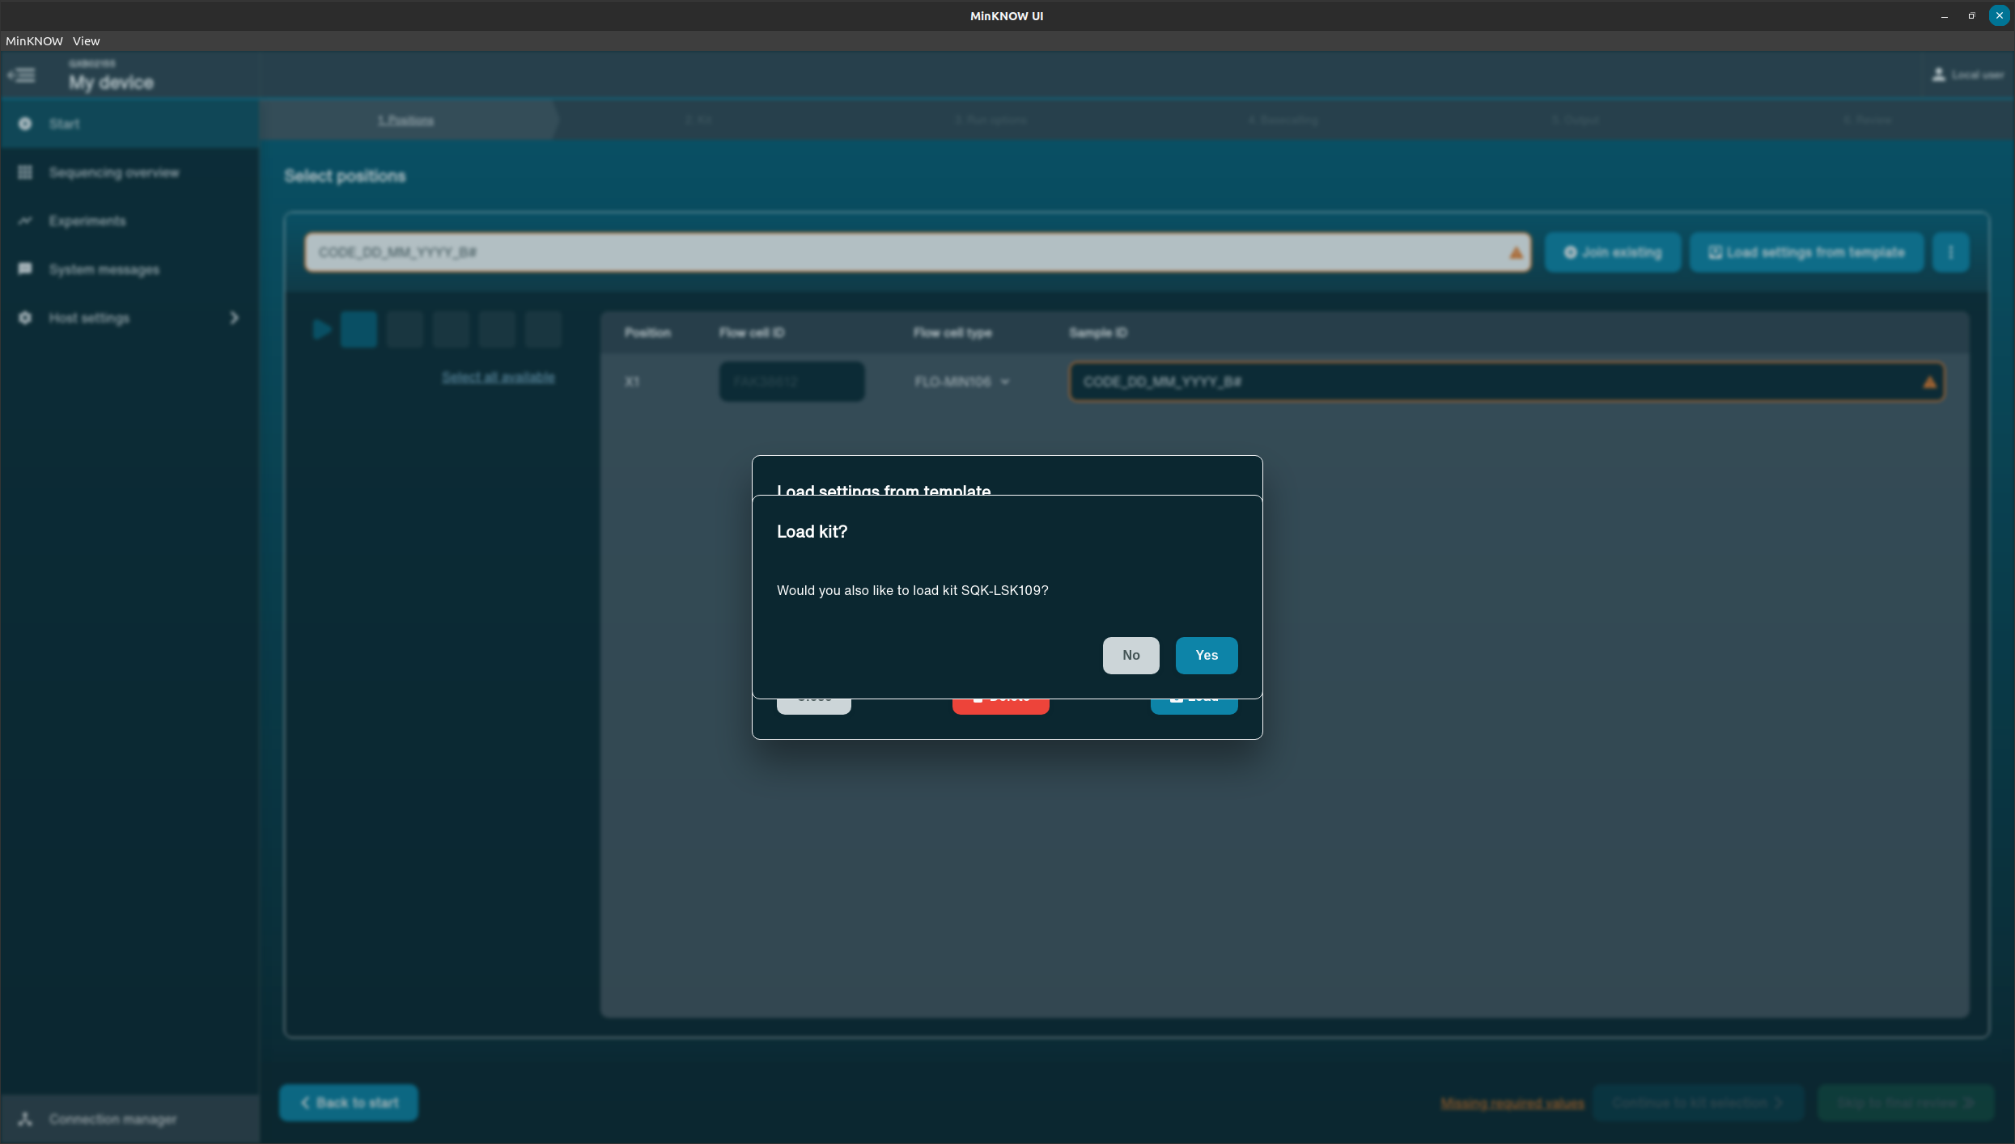
Run parameters

Slide 18
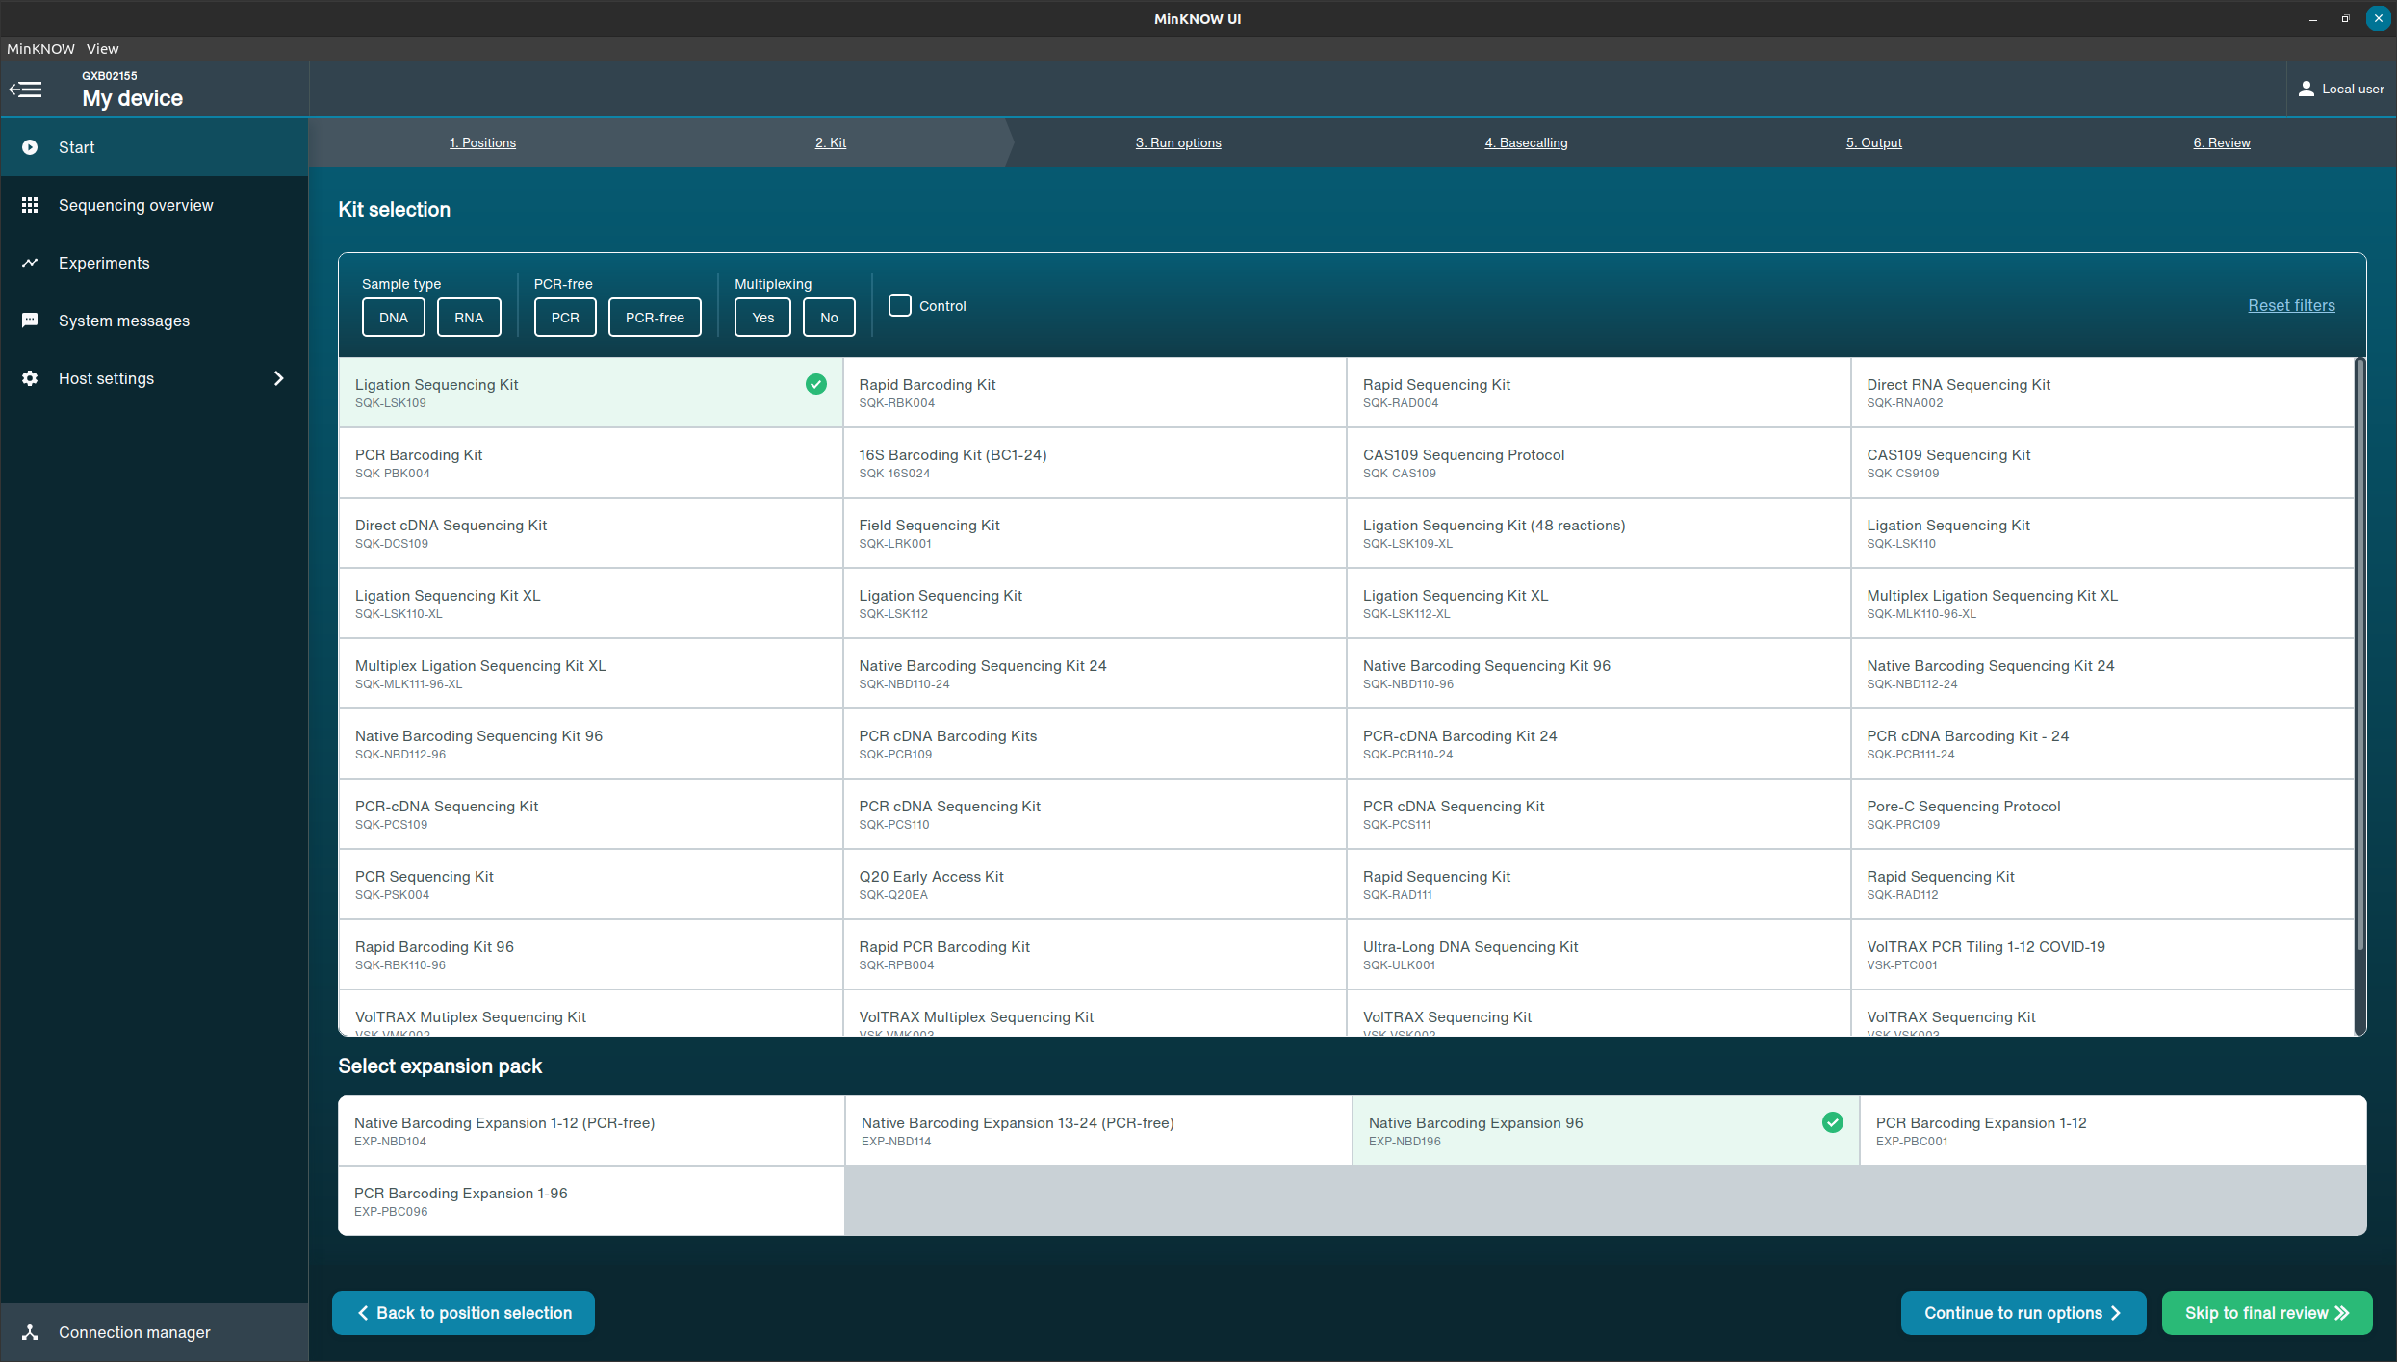
Run parameters
Library Preparation kit
Barcode Expansion kit

Slide 19
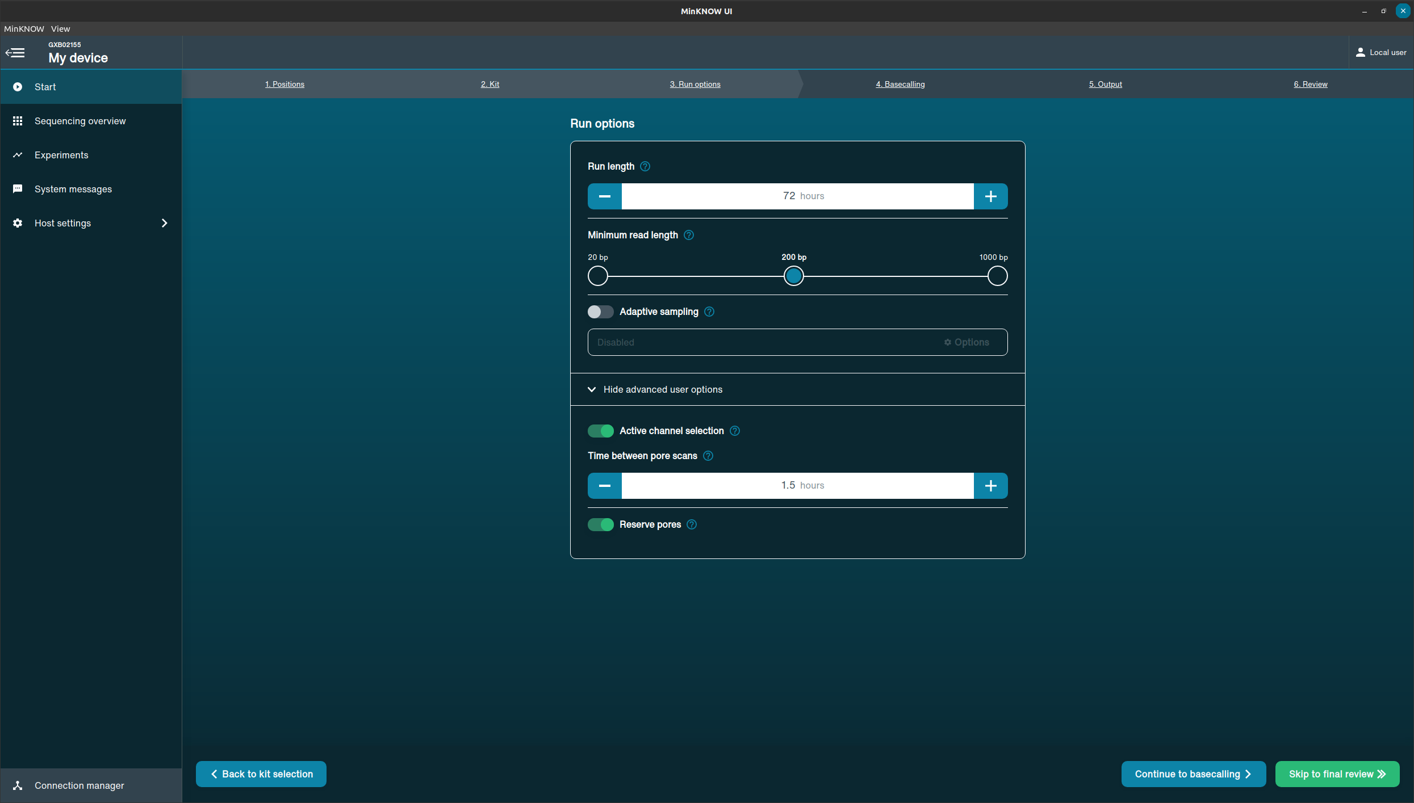
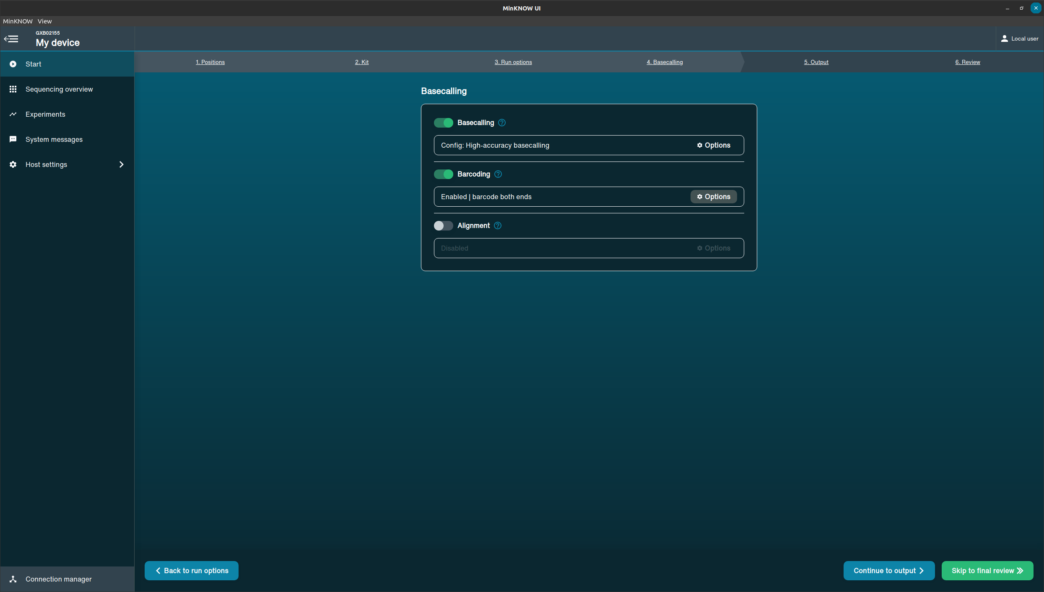
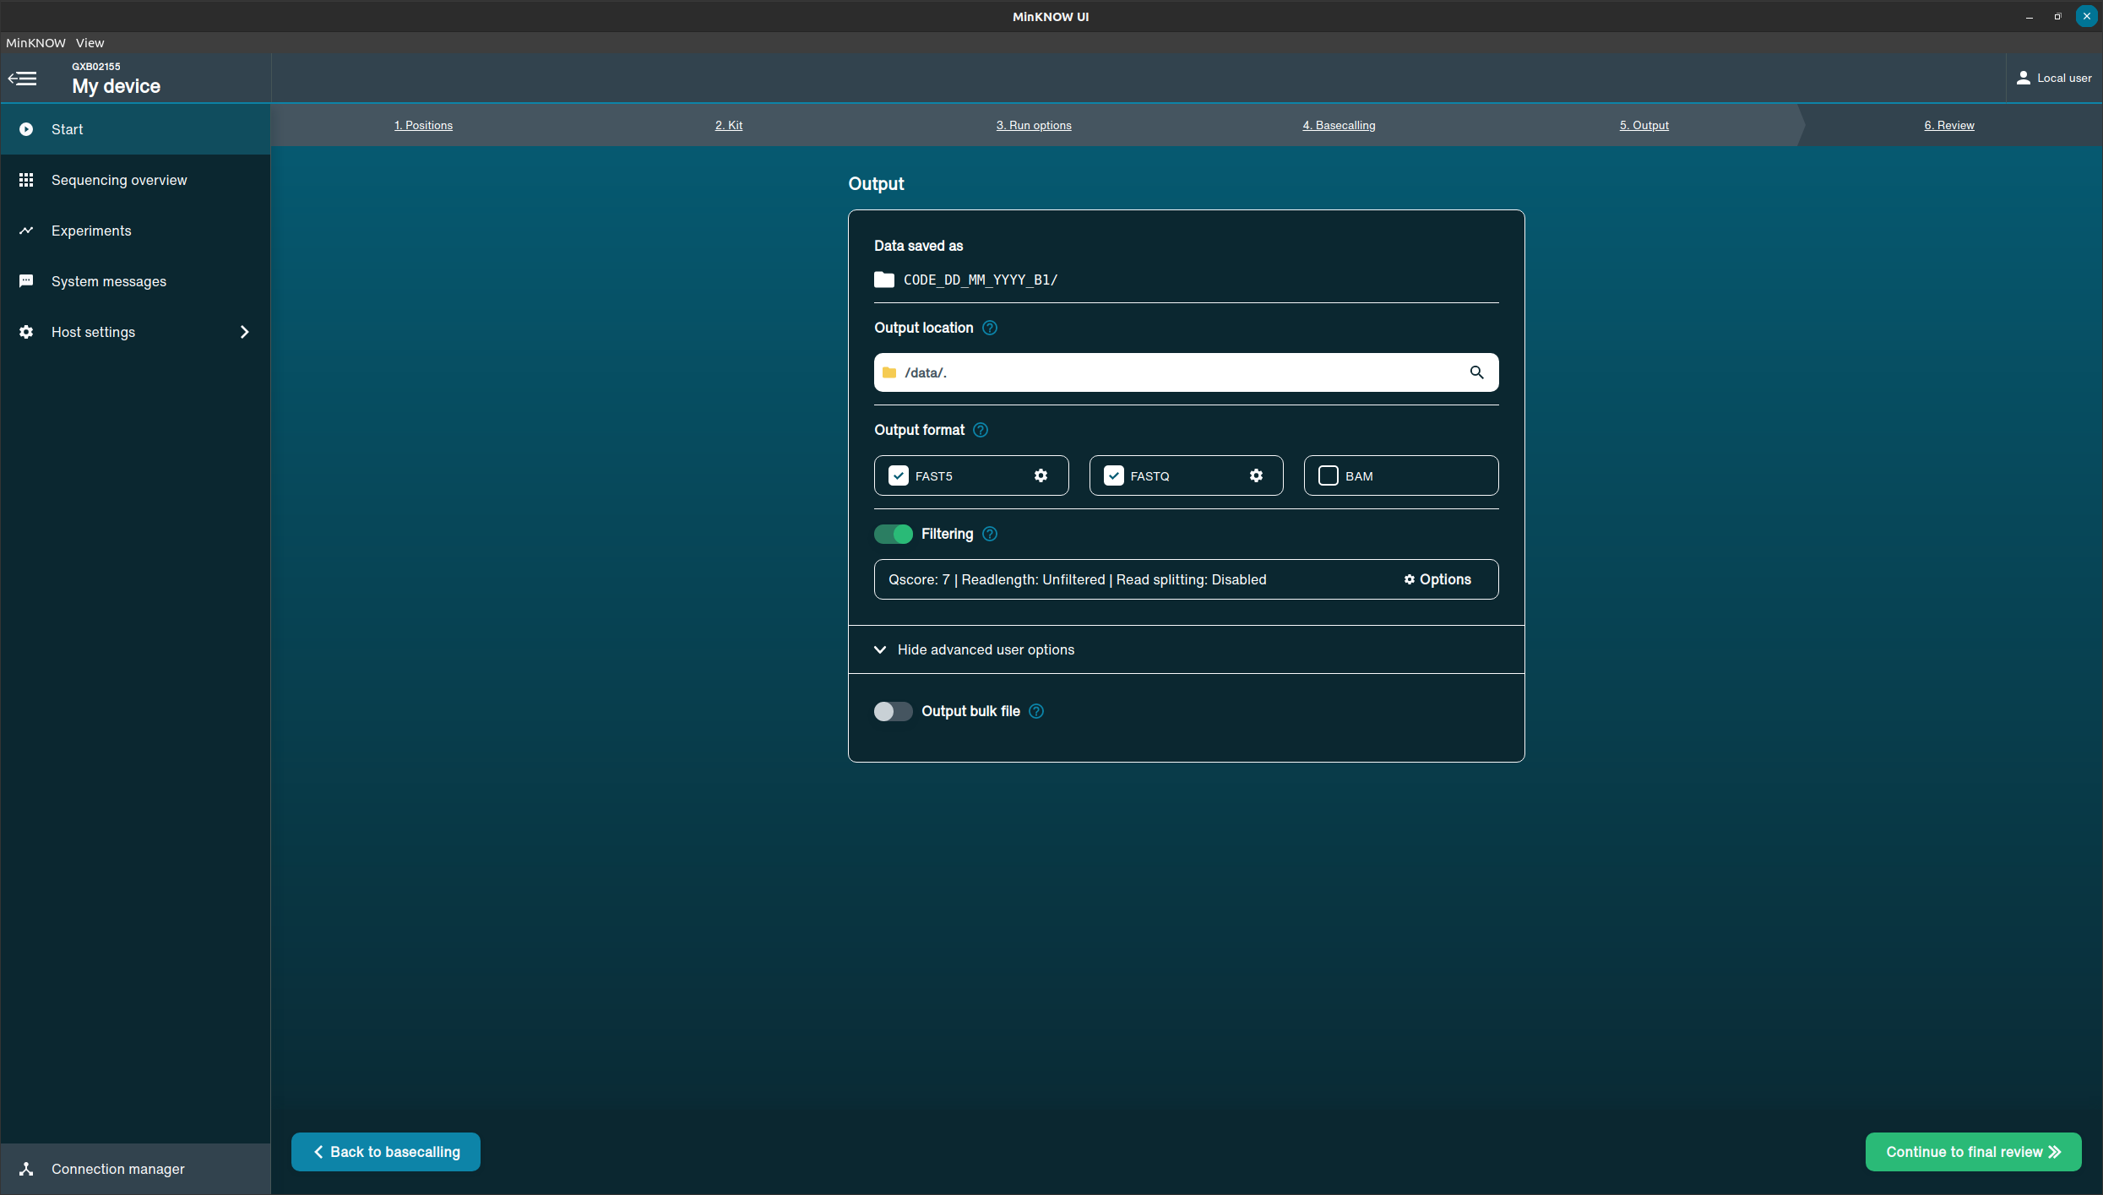
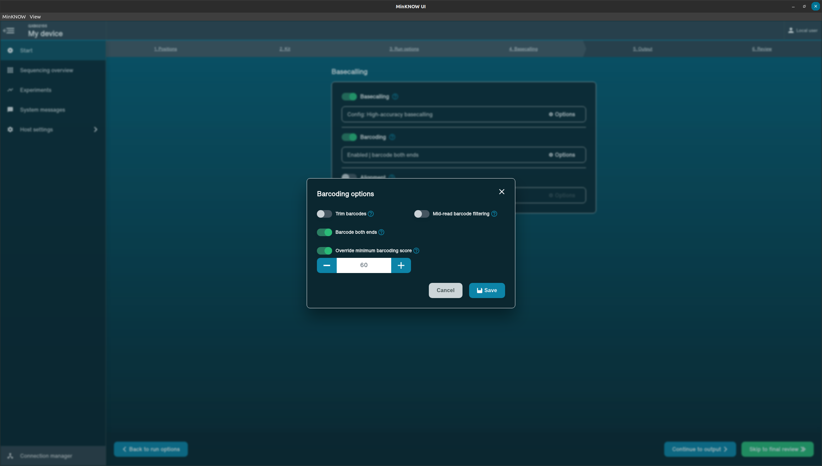
Run parameters

Slide 20
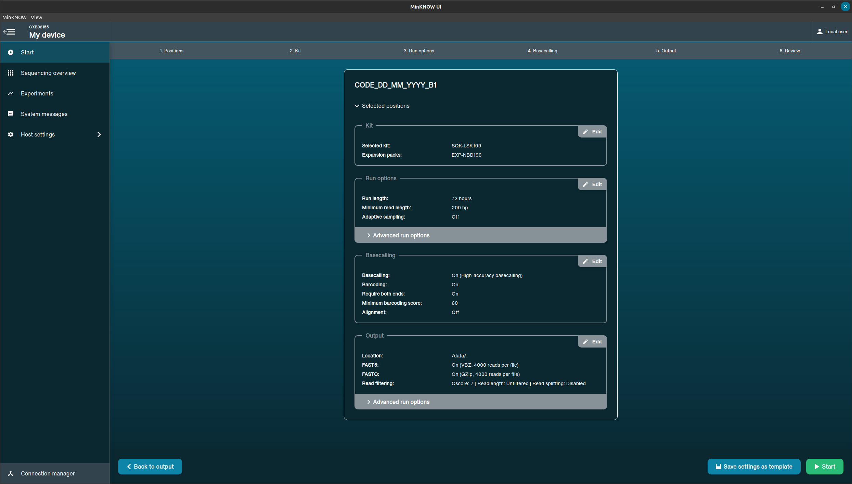
Run parameters
Notes:
Once you have reviewed and accept the run settings, simply hit start

Slide 21
